Slide 1
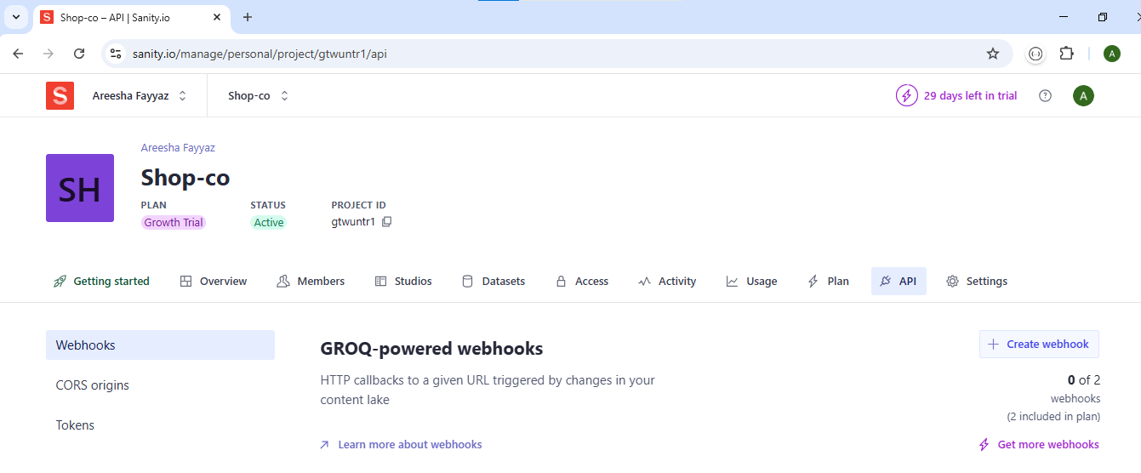
DAY 3 - API INTEGRATION AND DATA MIGRATION

Slide 2
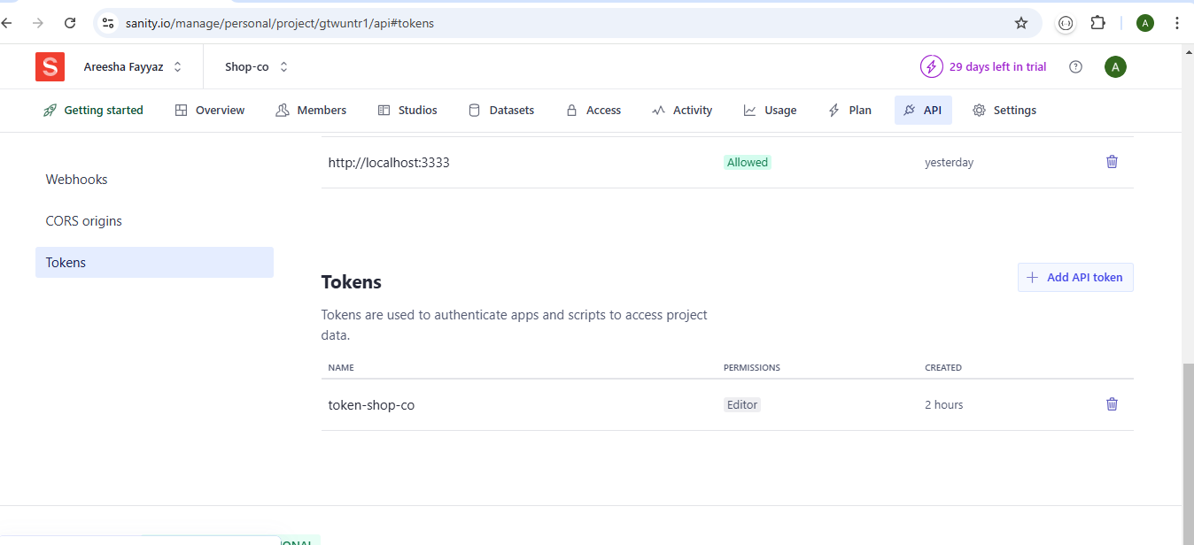
Generate Token:

Slide 3
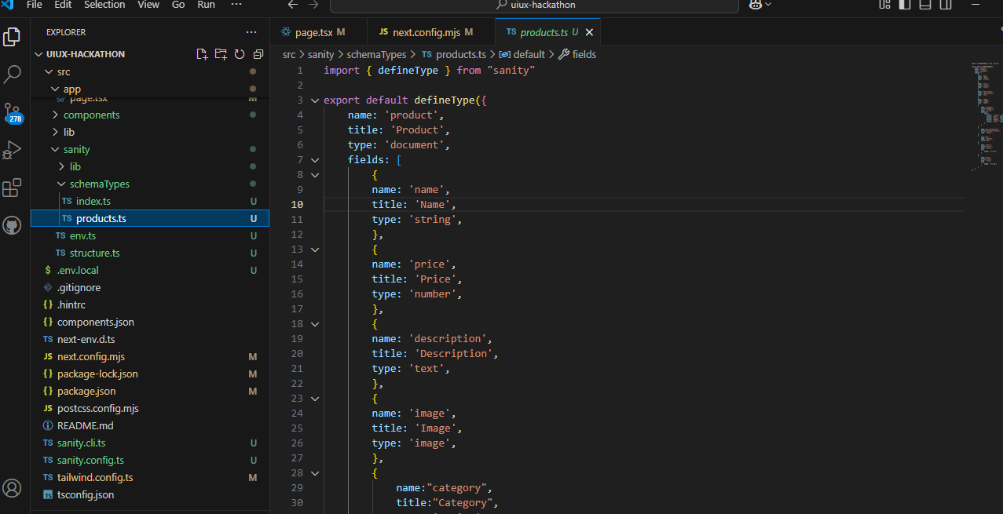
Add Api in Sanity/SchemaTypes/Product.ts

Slide 4
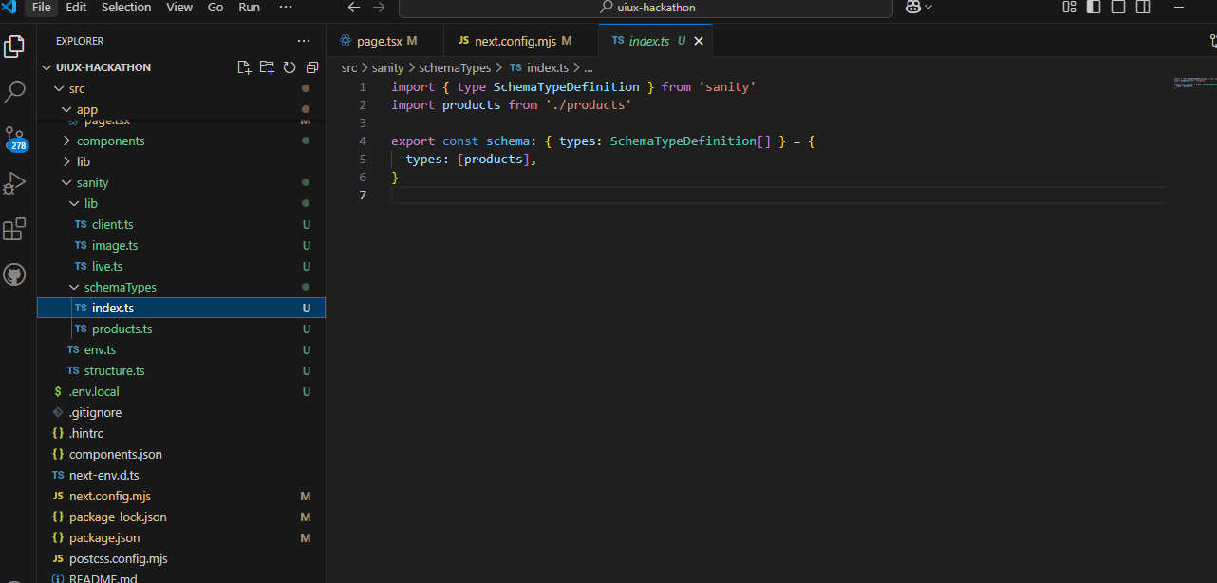
Import Product.ts file in index.ts

Slide 5
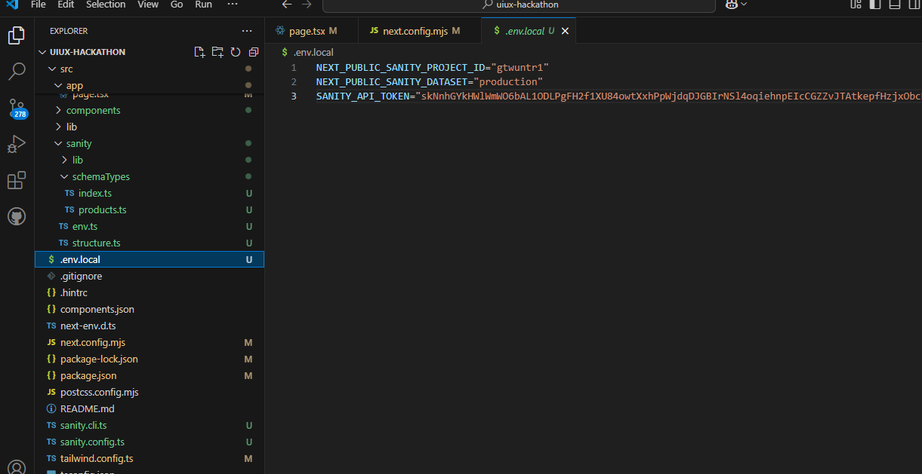
Add Token ID and Project ID in .evn.local file

Slide 6
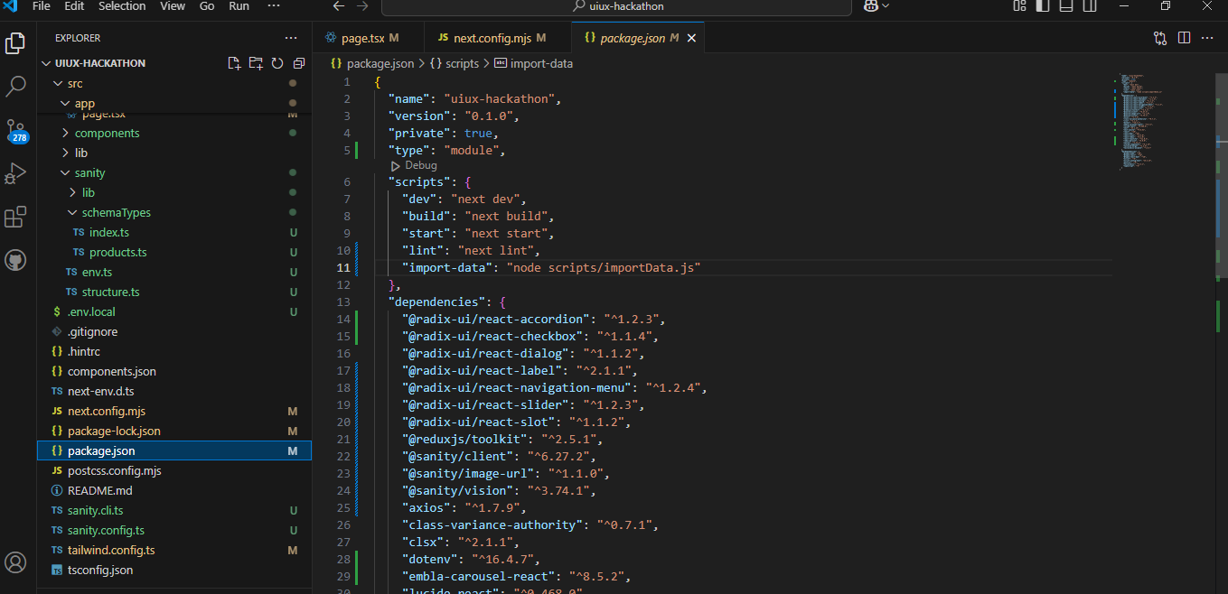
Package.json file:

Slide 7
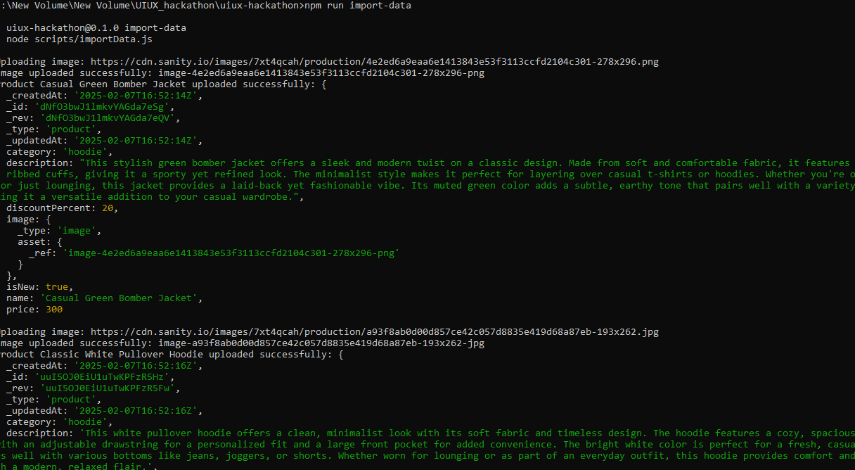
Import Data:

Slide 8
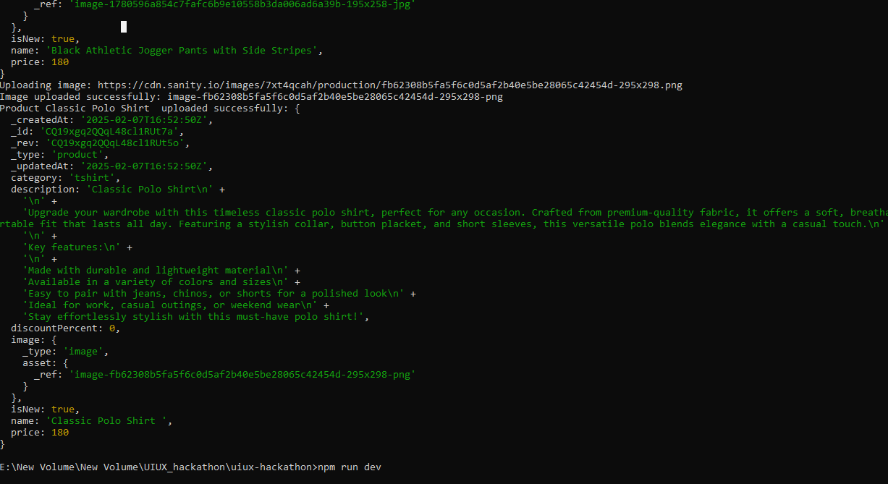
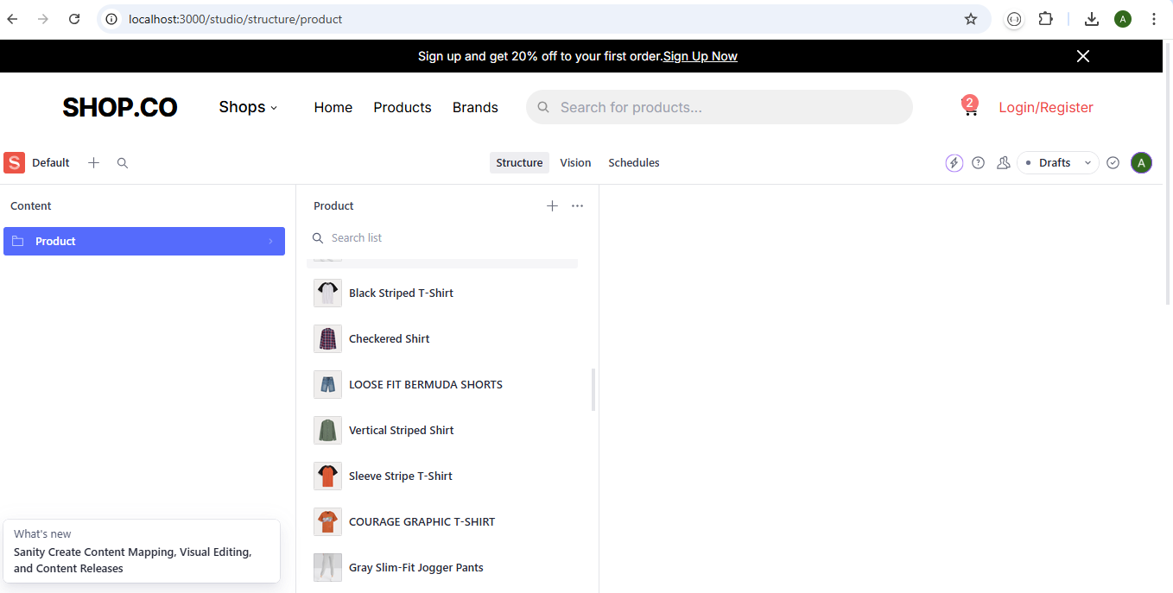
Fetch Data Successfully:

